Slide 1
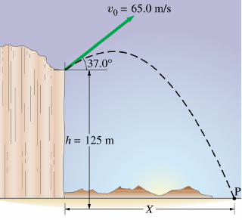
Problem
A projectile is fired from the edge of a cliff 125 m above the ground level with the speed of 65.0 m/s at an angle of 37.0° with the horizontal [a] Determine the time taken by the projectile to hit the point P on the ground level [b] Determine the range X of the projectile as measured from the base of the cliff. At the instant just before the projectile hits the point P [c] Determine the vertical and the horizontal components of its velocity [d] The magnitude of the velocity [e] The angle made by the velocity vector with the horizontal [f] Find the maximum height above the cliff top reached by the projectile.

