Slide 1
To suggest A ‘Generic’ Potential, The Website will promote all the following nine (9) models to their specific Demographic with a ‘Call to Action’ for each.
Portable Seat Cushions for Home, Office, Automotive and General Seating Enhancement (2).
Plus Aircraft models (1).
Small & Commercial Upholsterery Kits (1).
Sewing Enthusiast D-I-Y Kit (1)(two ‘calls to action’, one ‘sew a covering’ contest and….)
Seat and Chair Manufacturing Licenses (2)(a variety of seating applications including Aircraft.)
Consumers of our new ‘one of a kind’ Contour Ventilated Cushion (1)with;
A version especially for Burn Patients (1)(offered free to these users.)
The URLs We own:
www.thesmartcushion.com
www.smart-cushion.com
www.thetweetseat.com
FOR ALL DEMOGRAPHICS
FOR A YOUNGER
COLLEGE SET &
SOCIAL MEDIA DEMOGRAPHIC
Copyrights reserved 2011 M.Bernard Sheppard

Slide 2
When the Visitor goes or has been driven to the ‘Landing Page’ (Next Slide), They view the Video and See: WHAT’S IN IT FOR THEM, WHAT IT IS, WHAT IT DOES, etcetera. (Clicking through):
They Scroll to the Product Page (next slide) , with Nine moving Frames Showing (9) Nine PRODUCTS (ONE or MORE) SUITED FOR THEM, THEY LIKE FOR A PARTICULAR REASON;
Each model of interest will have a ‘CALL TO ACTION’ Buttons to be directed to:
Buy! Pay & Check Out. On a First Come First Served Basis, some models will not be available to ship early-on ‘Due to overwhelming Response’ ‘Until Tooling and is on line’ & Production catches up. With priority and fairness; Shipping Orders: singles, pairs, dozens, multiples, also F-C-F-S),
Multiple Means ( & Forms) to Promote, Publicize and Catapult Product Awareness.
2. Each Customer type will be ask, if they wish to; (Special Sign-up Forms under construction.) (Currently in my words)
Sign up to be listed on our production schedule and be notified when order is ready.
Sign up their Sewing Club or Organization (Affiliate).
Sign up for Future (D-I-Y) Sew-you-own-Covering Contest.
Sign up their Upholstery Business (Tax I.D.Required)
Sign up Company to Qualify for Wholesale. (Tax I.D.Required)
Sign up their Seat - Chair Manufacturing Company Interested in Licensing the Technology to be contacted by our Marketing Dept. (Tax I.D.Required)(???)
Sign up Your Burn Ward or Clinic for a Free Cushion for your recuperating Burn patients
Slides Copyrights reserved 2010 M.Bernard Sheppard
Our Contact Information e-mail: staytoond@gmail.com (423) 468-9512 Office/Message
M.Sheppard AQR,Inc. P.O.Box 6075, Chattanooga TN 37401-6075 Our FAX (423) 899-5174
Next; To the Landing Page

Slide 3



THE SMART CUSHION
∞
“ It’s Efffective Everywhere ”
OTHER PRODUCTS address only 1 or 2 sitting ailments
THE SMART CUSHION addresses All Nine (9) ailments
Here’s Why
Benefit to Your Body
See The Model and Application Right for You.
⬇ Scroll to Slide Show ⬇
Copyrights reserved 2010 M.Bernard Sheppard
Notes:
Slide (1) The (Default) Landing Page

Slide 4
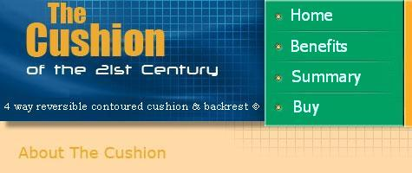
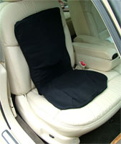
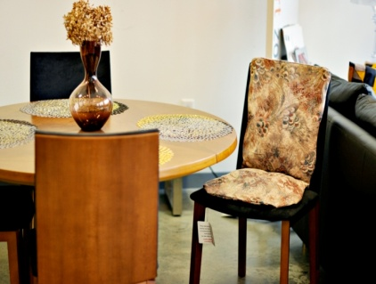
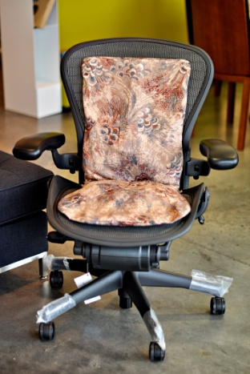

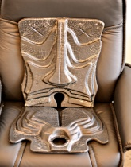
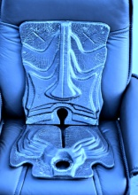
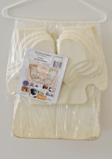
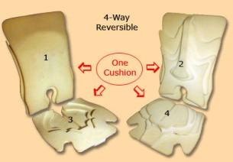
TheSmartCushion
There
EVERYWHERE
In the Home
The PORTABLE
READY TO USE
Covering
On The Road
At the Office
Portable
Aircraft
Outdoor
D-I-Y Covering Kit
Upholsters Retro-Kits
Seat-Chair Parts
Manufactures S
Notes:
Slide (2) Model #1 The Portable

Slide 5

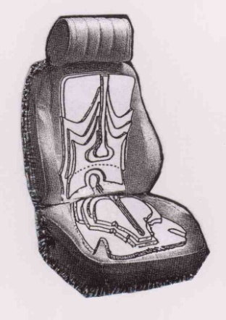
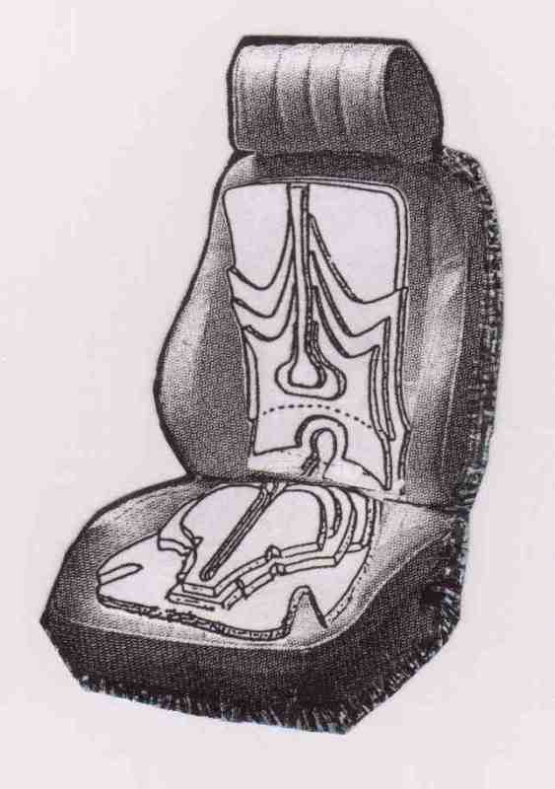

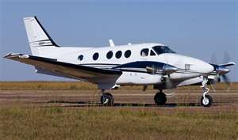
TheSmartCushion
There
ANYWHERE
… and in the Air
AIRCRAFT
‘READY TO USE’
SHOWN WITHOUT COVERING
Pilots and Co-Pilots
Seat and Chair
Aircraft
Aircraft
Integral Skin
Sew-Cover-Kit
Upholsters Retro-Kit
Manufactures Sub-Assembly Parts
Notes:
Slide (3) Model #2 Aircraft

Slide 6
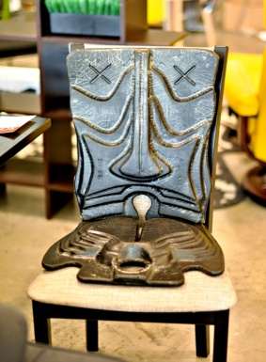
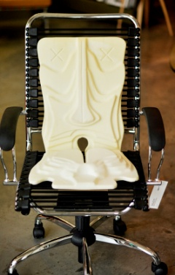
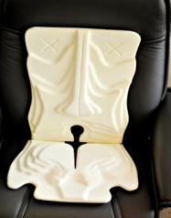
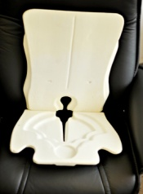
TheSmartCushion
There
ANYWHERE
“Art You
Sit On”
On The Water
PORTABLE
READY TO USE
OUTDOORS
“ … Has it’s own Skin”
Floatation Properties
Booster Clubs,
Print Your Team Color’n Logo
Seat and Chair
Aircraft
‘Free’ to Burn Patients *
Integral Skin
Sew-Cover-Kit
Upholsters Retro-Kit
Manufactures Sub-Assembly Parts
Anti-Microbial
Notes:
Slide (4) Model #3 Integral Skin

Slide 7
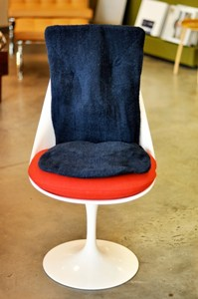
TheSmartCushion
There
“ .… For FUN or PROFIT ”
ANYWHERE
SEW-YOUR-OWN-COVER(s)
KIT
1 HR. PATTERN INCLUDED
Make For Your Road Warrior
For That Special Seat
For Your Home
Seat and Chair
Aircraft
‘Free’ to Burn Patients *
All Others w/Covering
Sew-Cover-Kit
Upholsters Retro-Kit
Manufactures Sub-Assembly Parts
Anti-Microbial Ventilated Cushion
Notes:
Slide (5) Model #4 Sew-Cover-Kit

Slide 8


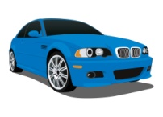
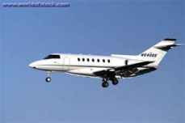
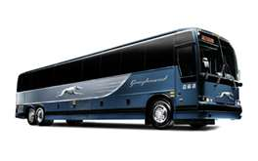
TheSmartCushion
ANYWHERE
Revenue
Revenue
Revenue
COMMERCIAL UPHOLSTERS RETRO-FIT KIT
Pattern Included
READY TO INSTALL
Revenue
Revenue
Seat and Chair
Aircraft
‘Free’ to Burn Patients *
All Others w/Covering
Upholsters Retro-Kit
Manufactures Sub-Assembly Parts
Anti-Microbial Ventilated Cushion
Notes:
Slide (6) Model #5 Upholsters Retro-Fit Kit

Slide 9

TheSmartCushion
There
TheSmartCushion
ANYWHERE
READY FOR
THE PRODUCTION FLOOR
Seat and Chair
Manufactures Sub-Assembly Parts
Seat and Chair
Aircraft
‘Free’ to Burn Patients *
All Others w/Covering
Manufactures Sub-Assembly Parts
Anti-Microbial Ventilated Cushion
Portable
Notes:
Slide (7) Model #6 Seat Chair Mfg. Part

Slide 10
TheSmartCushion
There
ANYWHERE
READY FOR
THE PRODUCTION FLOOR
Aircraft
Manufactures Sub-Assembly Parts
Aircraft
‘Free’ to Burn Patients *
All Others w/Covering
ub-Assembly Parts
Anti-Microbial Ventilated Cushion
Portable
Aircraft
Notes:
Slide (8) Model #7 Aircraft Mfg. Part

Slide 11

TheSmartCushion
There
ANYWHERE
Major Global Burn Clinics and Burn Wards Only Please Sign up for a Free Cushion for each Recuperating Burn Patients
Anti-Microbial Ventilated Cushion
PORTABLE
READY TO USE
‘Free’ to Burn Patients *
All Others w/Covering
Anti-Microbial Ventilated Cushion
Portable
Aircraft
Integral Skin
Sew-Cover-Kit
Notes:
Slide (9) Model #8 Burn Patient

Slide 12
TheSmartCushion
There
ANYWHERE
Anti-Microbial Ventilated Cushion
PORTABLE
READY TO USE
“The Worlds First Contoured Ventilated Cushion”
Covered Ventilated
Seat and Chair
Anti-Microbial
Ventilated Cushion
Portable
Aircraft
Integral Skin
Sew-Cover-Kit
Upholsters Retro-Kit
Manufactures Sub-Assembly Parts
Notes:
Slide (10) Model #9 Others Covered Ventilated

Slide 13
The as is existing page at: www.smart-cushion.com will be the click from the menu home page
USER new P.W. cushion09
! ! Recovered Backed-up Files 6/29, Don’t know what to do with them yet ! !
Slide # 13 in this Slide Show
Notes:
Slide (11) Home Page for the; www.thesmartcushion.com Home page Click to only

Slide 14
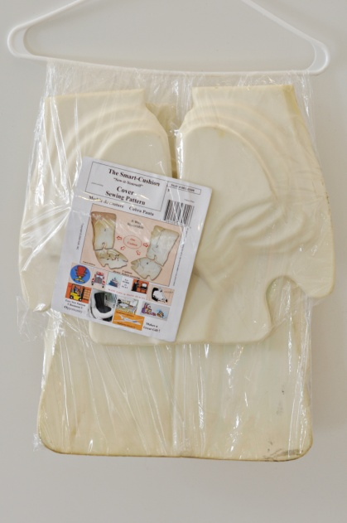
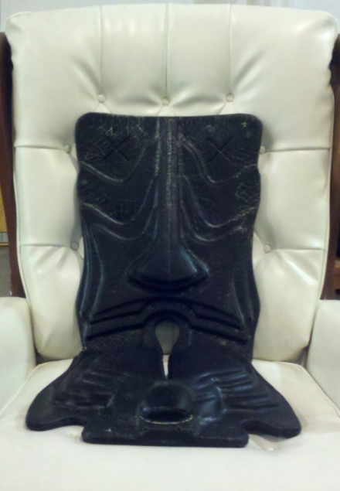
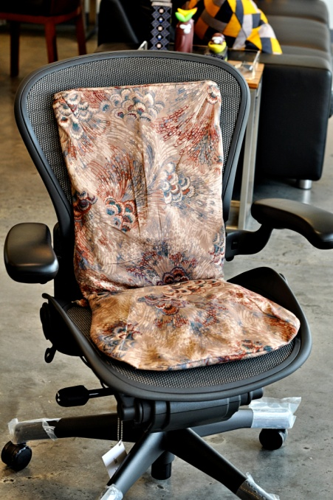
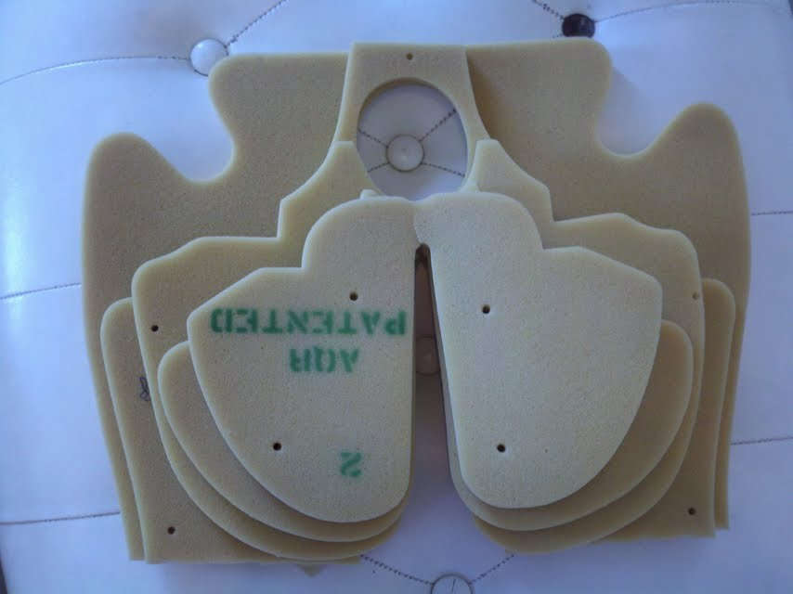
Pat.pend. SMART CUSHION
Business Plan
DIY kit
Retail
Seating
Manufacturing
Product
Commercial
Upholstery
Retrofit kit
$39.95
Sold Without
a Covering
$34.95 to $79.95
Sold With
and
Without a Covering
$ K Licensing Fees
$19.95 to $49.95
Sold Without Covering
Six sold without expensive fabric or sewing,
9 Models
Existing
Distribution Channels
Great margins…
Copyright2011 M.Bernard Sheppard
E-commerce, Direct, Wholesale, Retail, J-I-T to Manufacturers
Notes:
Why are we doing this?

Slide 15
Pat.pend. SMART CUSHION
Product Validation
Copyright2011M.Bernard Sheppard
Presently on the INTERNET, the visitor can learn, be the ‘decider’ and then tell others.
Our Future E-commerce Sites: www.smart-cushion.com & www.thetweetseat.com
Notice: In case of Success; To prevent failing due to popularity and overwhelming initial orders, we’ll rapidly tool up to fill orders as we display the following messages;
THIS POP-UP response to Buy, Checkout, or Shopping Cart Selection, QUOTE;
Thank you for visiting. “Due to an overwhelming response for the Smart-Cushion, we’re “Now Accepting Pre-Orders” accepting no money until your order is ready. Opt-in Offer: Fill out the form; “To be placed on our production schedule, receive E-Mail Notification to you when your order is ready and payment is due (in approx ____ weeks) .”
Some models may be available and payment due when ordered.
We appreciate your patience. We are working hard to correct this condition.”
Thank You
CONTACT INFORMATION ON SLIDE #3

