Slide 1
National Cranberry Cooperative
Process Flow:
Receiving Cranberries
Weighing
Sampling
Grading
Dumping (If the dumping cannot be performed cranberries are held in the trucks until they can be processed)
Storing Cranberries into Bins
Dry bins
Dual bins (you have to decide how these dual bins are allocated)
Wet bins

Slide 2
Process Flow
Process breaks into two different patterns for dry and wet cranberries at this point:
Dry Crop:
Destoning
Dechaffing
Seprators/Baily Mill
Packaging
Wet Crop:
Dechaffing
Drying
Seprators/Baily Mill
Packaging

Slide 3
Assumptions
18,000 bbls per day uniformly distributed over 12 hours starting 7am.
Average truck delivery load is 75 bbls.
70% of the berries are wet.
Bailey mill rates are same as the separators and the Bailely mill process time is determined based on the second quality berries not the potential second quality berries.
Figures D and E, will give you the start time of each process and number of both types of workers available.
Do not compute overtime from figure E, overtime should be computed so that there are no cranberries left in the system.

Slide 4
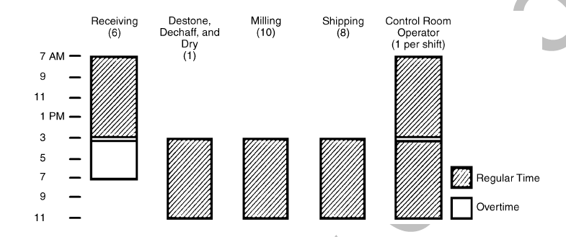
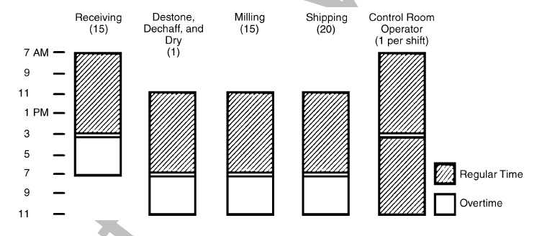

Slide 5
Questions
What are the problems RP1 facing?
All the problems that are mentioned in the case and anything extra that comes to your mind.
Draw process flow.
What is the bottleneck?
Remember that only processes can be bottleneck.
Do not forget to consider the number of machines in each station.
How does the backlog grows on a peak day?
Using Figure E and the bottleneck rate you can compute how the inventory of cranberries in the system will change.
The difference between what can be kept in the system and what is cumulated in the system is how the backlog is growing.

Slide 6
Questions
How much overtime labor is used, how much money does that represent?
Comparing number of workers in each section in Figure E with Figure D you can compute the number of regular and seasonal workers.
Considering the changes in the backlog from the previous case and number of workers in each section from Figure E you can compute the total overtime cost.
How much waiting cost is incurred?
Using the information above and the method explained at the end of assumptions you would be able to compute this.
Remember that wait cost is per truck waiting not per barrel.
What recommendations?
Buying dryers and/or converting bins? Do the cost analysis and determine how many dryers you would buy and how many bins would you pay for if any.
Any recommendation independent of equipment purchase?

