Slide 1
How to Draw a Process Flowchart
Dr. Roger Rensvold
Feb 2014

Slide 2
Basics Nishadha (2011). Ultimate flowchart guide. Retrieved on 7 Feb 2014 fromhttp://creately.com/blog/diagrams/flowchart-guide-flowchart-tutorial/#FlowchartSymbols (See embedded links)
Four main types
Document
Data
Program
System (we’ll look at this type).

Slide 3
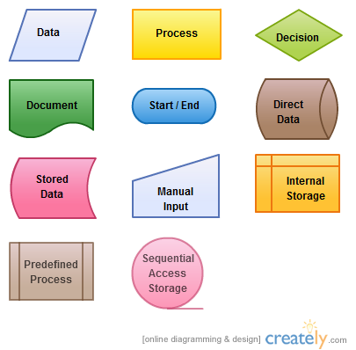
Symbols
Many symbols are only used for special flowcharts: e.g., data.
We’ll only use the symbols marked with
Chart arrows
indicate sequential direction of
process flow.

Slide 4
Process: Making vegetable soup.
Narrative description:
Check the recipe. If you have all the stuff you need, proceed. If you don’t, go to the store and buy it. Put a pot of water on the stove. While the water is heating, chop the vegetables. When water is boiling, add vegetables and spices to the water. From time to time, taste the soup. Add seasoning (salt and spices) to taste. When the soup tastes OK and the vegetables are tender, serve it.
The flowchart (next page):

Slide 5
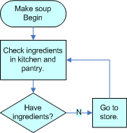
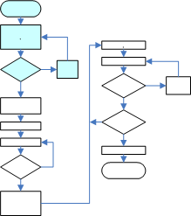
Begin. Check the ingredients in your kitchen and pantry. Have everything? If yes, proceed. If no, go to the store. Have everything now? If yes, proceed. If no, curse and go back to the store. Repeat until you finally have everything. (This iterative process is called a LOOP.) Notice the clear distinction between processes, in boxes, and decisions, in lozenges (squashed diamonds). Don’t mix them up!
The steps:
The steps in the process:
Y

Slide 6
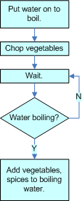
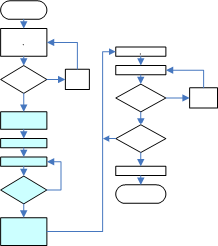
Once you have your stuff together (previous step), put the water on to boil and chop the vegetables. Is the water boiling? If no, wait. If yes, add the vegetables and spices to the boiling water.
The steps:
The steps in the process :

Slide 7
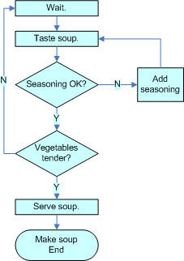
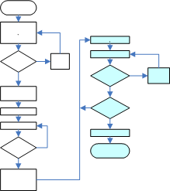
After putting everything on (previous step), wait. Taste the soup. Seasoning OK? If yes, continue. If no, add seasoning and taste again. Are the vegetables tender? If yes, serve the soup. If no, wait and taste again. When seasoning is OK and veggies are tender, serve the soup.
The steps:
The steps in the process:

Slide 8
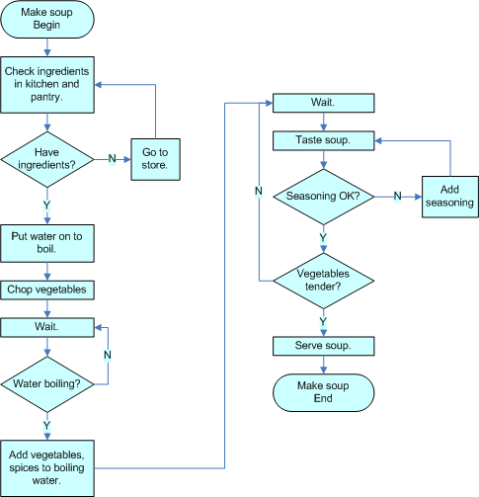
Here’s the whole process.
This is OK, but some may think
it’s a bit crowded. Let’s break
it up over three separate pages
using references. These are
arrowhead – shaped boxes with
numbers in them (next page).

Slide 9
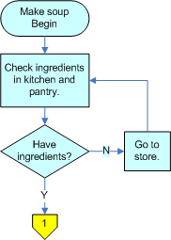
Connecting page 1 to page 2, using the
reference.
Page 1 Page 2
(The colors aren’t necessary, and the numbers are arbitrary. You could also use A, B, C … or a,b,c… or I, II, III, … or whatever.)

Slide 10
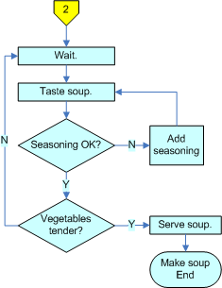
Connecting page 2 to page3, using the
reference.
Page 2 Page 3

Slide 11
So how do I actually DRAW one of these things?
Use a graphics app:
Neatly hand-drawn & scanned:
MS Visio (best, but $$. Buying it solely for this assignment would be like buying a Rolls and driving it nowhere but to the grocery store.)
http://office.microsoft.com/en-us/visio/
SmartDraw (free trial) http://www.smartdraw.com/
MS Word – you’ve already got it! Dozens of tutorials on the Web; Google “MS Word drawing tutorial.” There’s a good one at
www.northcanton.sparcc.org /…
Or, just DRAW it! Use a black
Sharpie on white paper. Scan.

Slide 12
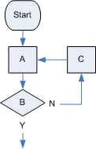
To reduce clutter, key the flowchart entries to a glossary. Example:
Glossary
Flowchart
A: Check ingredients in refrigerator and pantry
B: Everything needed on hand?
C: Go to store.
…etc.
This can be a lot neater, esp. if
drawing the flowchart by hand.
…end…

