Slide 1
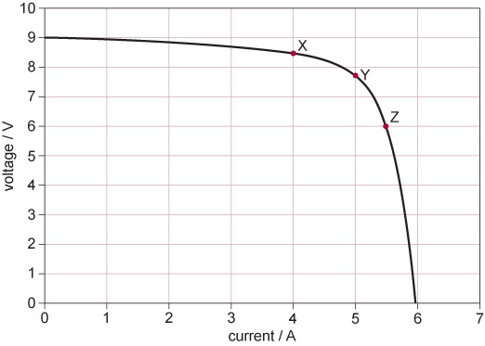
Figure 1 Output characteristic of a PV module

