Slide 1
Chapter 2: Displaying and Summarizing Data
Part 2: Descriptive Statistics

Slide 2
Excel Support
Excel statistical functions
Analysis Toolpak tools
PHStat tools and procedures

Slide 3
Descriptive Statistics
Frequency distributions and histograms
Measures of central tendency
Measures of dispersion
Measures of shape
Data profiles
Coefficient of variation
Correlation

Slide 4
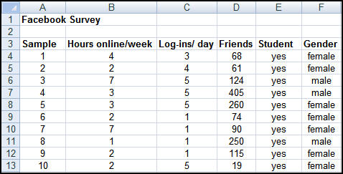
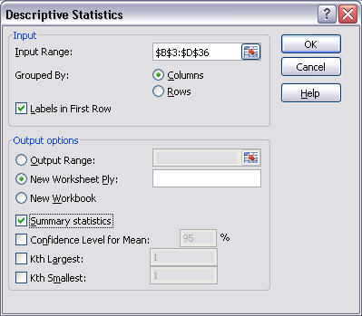
Excel Descriptive Statistics Tool

Slide 5
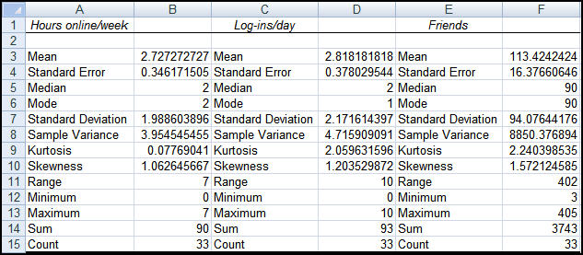
Facebook Survey Results

Slide 6
Terminology and Notation
Parameter – a measurable characteristic of a population: μ is a parameter, ‾x is not
x_{i} represents the i^{th} observation
∑ indicates the operation of addition
N is the size of the population; n is the size of the sample
f_{i} is the number of observations in cell i of a frequency distribution

Slide 7
Arithmetic Mean
Population
Sample
Excel function AVERAGE(range)

Slide 8
Properties of the Mean
Meaningful for interval and ratio data
All data used in the calculation
Unique for every set of data
Affected by unusually large or small observations (outliers)
The only measure of central tendency where the sum of the deviations of each value from the measure is zero; i.e.,
∑(x_{i} – x ) = 0

Slide 9
Median
Middle value when data are ordered from smallest to largest. This results in an equal number of observations above the median as below it.
Unique for each set of data
Not affected by extremes
Meaningful for ratio, interval, and ordinal data
Excel function MEDIAN(range)

Slide 10
Mode
Observation that occurs most frequently; for grouped data, the midpoint of the cell with the largest frequency (approximate value)
Useful when data consist of a small number of unique values

Slide 11
Midrange
Average of the largest and smallest observations
Useful for very small samples, but extreme values can distort the result

Slide 12
Measures of Dispersion
Dispersion – the degree of variation in the data.
E.g., {48, 49, 50, 51, 52} and {10, 30, 50, 70, 90}
Range – difference between the maximum and minimum observations
Same issues as with midrange

Slide 13
Variance
Population
Sample
Excel functions VARP, VAR

Slide 14
Standard Deviation
Population
Sample
The standard deviation has the same units of measurement as the original data, unlike the variance
Excel functions STDEVP, STDEV

Slide 15
Grouped Data: Calculation of Mean
Sample
Population
In a frequency distribution, replace x_{i} with a representative value (e.g., midpoint)

Slide 16
Grouped Data: Calculation of Variance
Sample
Population

Slide 17
Chebyshev’s Theorem
For any set of data, the proportion of values that lie within k standard deviations of the mean is at least 1 – 1/k², for any k > 1
For k = 2, at least ¾ of the data lie within 2 standard deviations of the mean
For k = 3, at least 8/9, or 89% lie within 3 standard deviations of the mean
For k = 10, at least 99/100, or 99% of the data lie within 10 standard deviations of the mean

Slide 18
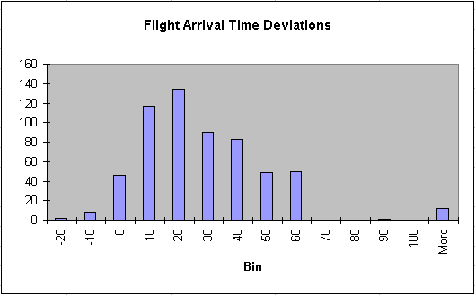
Example
Mean = 28.87; standard deviation = 21.92
3σ about the mean: [-36.9, 94.6]
2σ about the mean: [-15.0, 72.7]

Slide 19
Coefficient of Variation
CV = Standard Deviation / Mean
CV is dimensionless, and therefore is useful when comparing data sets that are scaled differently.

Slide 20
Frequency Distribution
Tabular summary showing the frequency of observations in each of several non-overlapping (mutually exclusive) classes, or cells
Relative frequency – fraction or proportion of observations that fall within a cell
Cumulative frequency – proportion or percentage of observations that fall below the upper limit of a cell

Slide 21
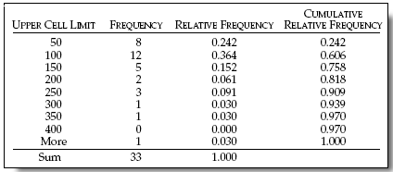
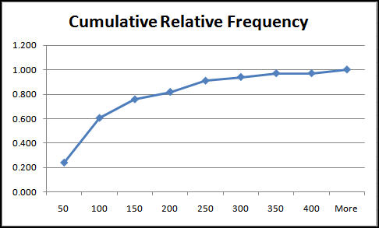
Example: Facebook Friends

Slide 22
Histogram
Column chart representing a frequency distribution

Slide 23
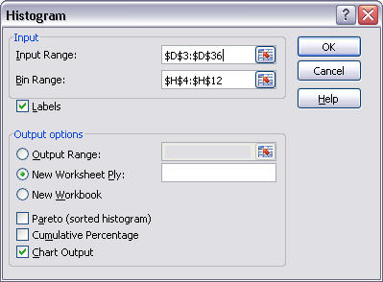
Excel Tool: Histogram
Excel Menu >Tools > Data Analysis > Histogram
Specify range of data
Define and specify bin range (recommended)
Select output options (always check Chart Output

Slide 24
Good Practice Guidelines
Cell intervals should be of equal width.
Choose the width using the formula
(largest value – smallest value)/number of cells
but round to reasonable values
(e.g., 97 to 100)
Choose somewhere between 5 to 15 cells to provide a useful picture of the data

Slide 25
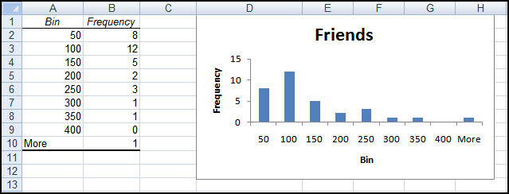
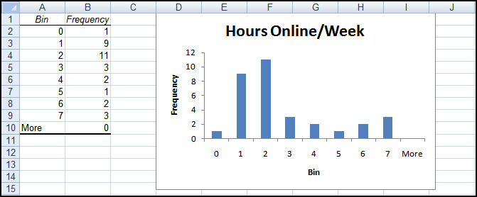
Examples from Facebook Survey

Slide 26
Excel Frequency Function
Define bins
Select a range of cells adjacent to the bin range (if continuous data, add one empty cell below this range as an overflow cell)
Enter the formula =FREQUENCY(range of data, range of bins) and press Ctrl-Shift-Enter simultaneously.
Construct a histogram using the Chart Wizard for a column chart.

Slide 27
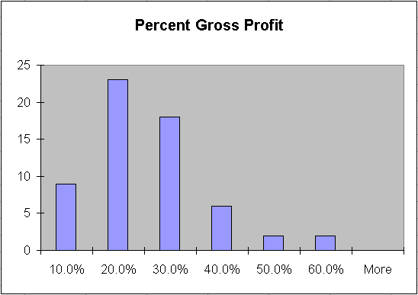
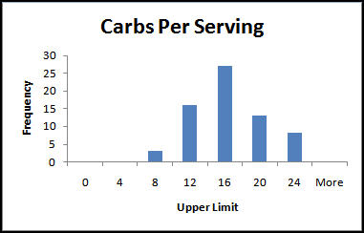
Skewness
Coefficient of skewness (CS)
-0.5 < CS < 0.5 indicates relative symmetry
Relatively Symmetric Positively skewed

Slide 28
Kurtosis
Refers to the peakedness or flatness of a distribution.
Coefficient of kurtosis (CK)
CK < 3: more flat with wide degree of dispersion
CK >3 more peaked with less dispersion
The higher the kurtosis, the more area in the tails of the distribution

Slide 29
Data Profiles (Fractiles)
Describe the location and spread of data over its range
Quartiles – a division of a data set into four equal parts; shows the points below which 25%, 50%, 75% and 100% of the observations lie (25% is the first quartile, 75% is the third quartile, etc.)
Deciles – a division of a data set into 10 equal parts; shows the points below which 10%, 20%, etc. of the observations lie
Percentiles – a division of a data set into 100 equal parts; shows the points below which “k” percent of the observations lie

Slide 30
Statistical Relationships
Correlation – a measure of strength of linear relationship between two variables
Sample correlation coefficient
Covariance – average of the products of the deviations of each variable from its mean; describes how two variables move together
Sample covariance

Slide 31
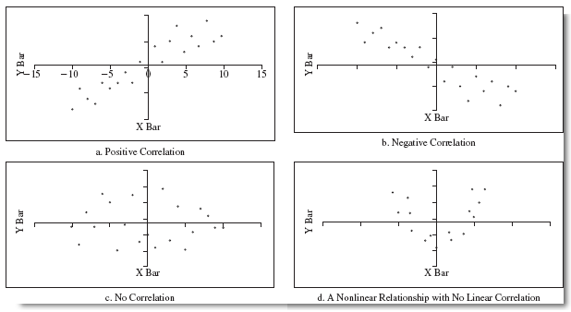
Examples of Correlation

Slide 32
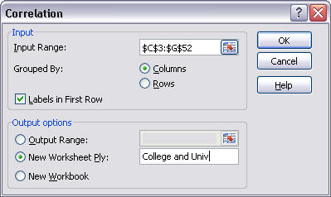
Excel Tool: Correlation
Excel menu > Tools > Data Analysis > Correlation

Slide 33
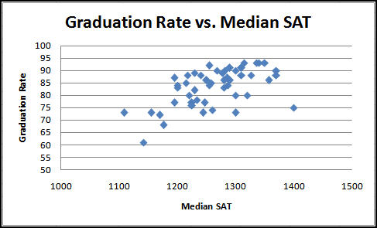
Colleges and Universities Data

Slide 34
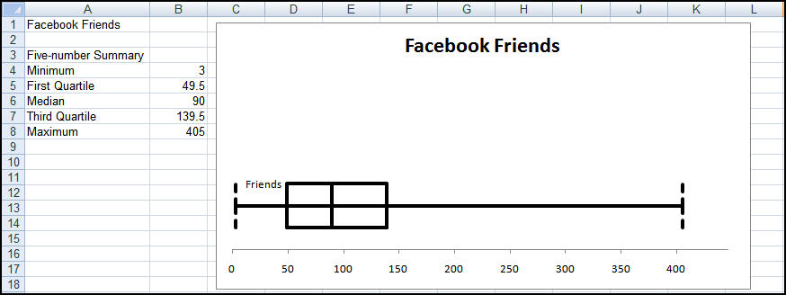
Box and Whisker Plots
Display minimum, first quartile (Q₁), median, third quartile (Q₃), and maximum values graphically
min 1st quartile median 3rd quartile max

Slide 35
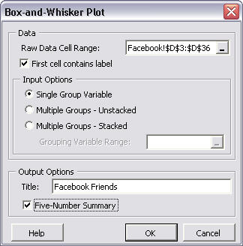
PHStat Tool: Box and Whisker Plot
PHStat menu > Descriptive Statistics > Box and Whisker Plot
Enter data range
Choose type of data set
Check box for five number summary

Slide 36
Stem and Leaf Display
Each number is divided into two parts: x | y x = stem, and y = leaf
Stem = cell; leaf = value within cell
Number Stem ⏐ Leaf
117 11 ⏐ 7
113 11 ⏐ 3
124 12 ⏐ 4
125 12 ⏐ 6
Stem and leaf display aggregates and sorts all leaves within the same stem:
11⏐37
12⏐46

Slide 37
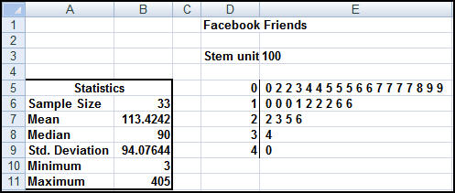
Stem and Leaf
Stem unit is a power of 10; the higher the stem unit, the more aggregation of data

Slide 38
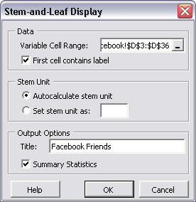
PHStat Tool: Stem and Leaf Display
PHStat menu > Descriptive Statistics > Stem and Leaf Display
Enter data range
Select stem unit or autocalculation
Check Summary Statistics box

Slide 39
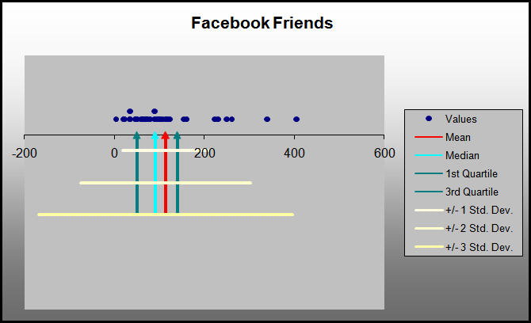
Dot Scale Diagram
PHStat menu > Descriptive Statistics > Dot Scale Diagram

Slide 40
Categorical Data: Proportions
Proportion - fraction of data that has a certain characteristic
Use the Excel function COUNTIF(data range, criteria) to count observations meeting a criterion to compute proportions.

Slide 41
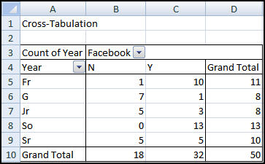
Cross-Tabulation (Contingency Table)

