Slide 1
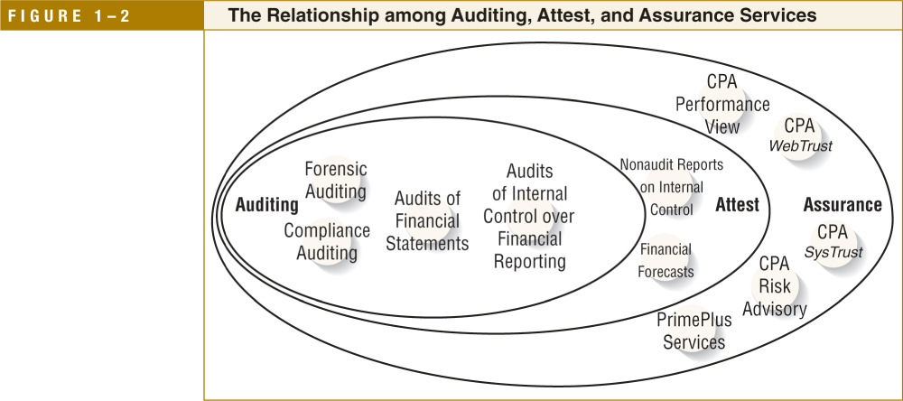
Relationships among Auditing, Attest, and Assurance Services
LO# 4

Slide 2
Relationships among Auditing, Attest, and Assurance Services
LO# 4

Slide 3
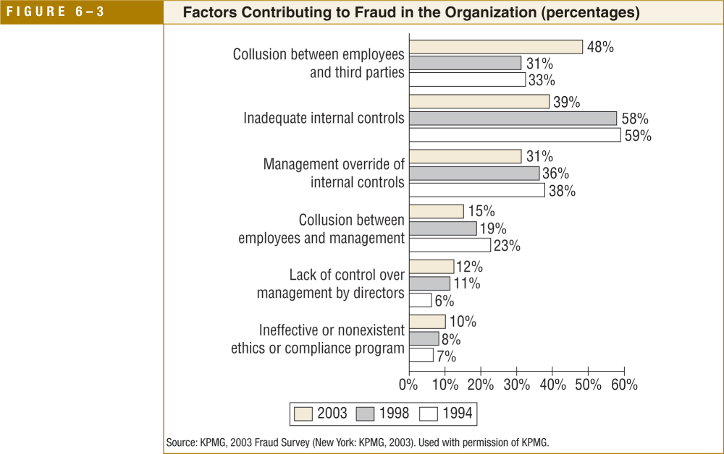
Factors Contributing to Fraud
LO# 7

Slide 4
Reference
Messier, W. F., Jr., Glover, S. M., & Prawitt, D. F. (2008). Auditing & assurance services: A systematic approach (6th ed.) Boston, MA: McGraw-Hill Irwin.
Note:
Figure 1-2 taken from page 12
Table 1-2 taken from page 13
Figure 6-3 taken from page 208

