Slide 1
MOIC L4 - Individual Change (3): Personal Resilience
Dr. Peter Simpson

Slide 2
A Quick Review of MOIC so far…
Aptitudes sought by Employers…
‘Skills’ and ‘how’ evidenced - qualification or experience? Motivation Confidence Resilience Initiative Interpersonal Influence Emotional Intelligence Open-minded Problem-solving Team working Independent working http://myfuture.uwe.ac.uk/RenderPages/RenderLearningObject.aspx?Context=7&Area=3&Room=109&Constellation=73&LearningObject=284
Study Unit 4
Study Unit 3
Study Unit 5

Slide 3
Your work of Personal and Professional Development
Learning about Individual Change Management through
Reflection on experience
Developing knowledge and understanding of theory and literature
Improving analytical capability to use theory to reflect on and learn from experience
Critically evaluating theory and experience to make appropriate judgements
Using insight and learning to plan for future professional and career development

Slide 4
Lecture Overview
Resilience
Resilience and Renewal
Positive and Negative Emotional Attractors
16PF Personality Assessment
The sixteen personality factors
The global factors (cf Big Five)
Open-mindedness
Initiative

Slide 5
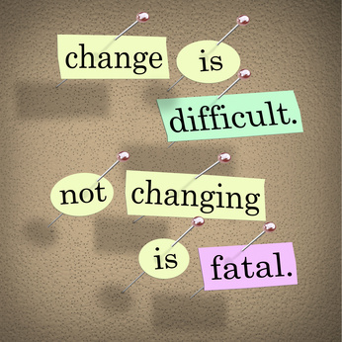
Why we need Resilience…
… Change is Hard
https://www.youtube.com/watch?v=RpiDWeRN4UA

Slide 6
Resilience
Ability to withstand or recover quickly from difficult conditions (Oxford English dictionary). Employer's definition: 'Bounces back from failures or personal knocks. Copes positively with setbacks.' 'Determined endeavour in a pressurised environment.'

Slide 7
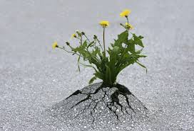
Resilience ‘Fall down seven times, get up eight.’ Japanese proverb
An increasingly important and valued skill or capacity in modern organisations:
‘The self-assurance and resilience of low (Apprehension) scorers are valued in a range of occupations, especially those that involve positive self-representation, confident decision making, or dealing with stress… such as salesperson, manager, executive, banker, marketer, and lawyer…’
Cattell & Schuerger (2003: 113)

Slide 8
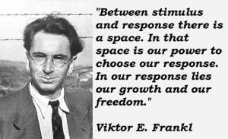
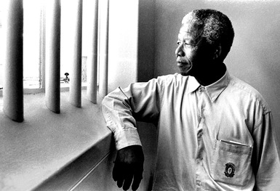
Resilience…
What does the term mean to you?
Who comes to mind when you think of someone who is very resilient?
What characteristics do these people possess?
Viktor E. Frankl, Man's Search for Meaning

Slide 9
Resilience as Carpet Dancing!
Instead of seeing the rug being pulled from under us, we can learn to dance on a shifting carpet
Thomas Crum, 1987

Slide 10
Resilience and Renewal
‘Stress is a part of our lives and essential to our survival and adaptation. But if stress becomes chronic , it causes rifts in our awareness, and eventually erodes our cognitive, perceptual, and emotional openness and performance. Fortunately, the human body and mind have a built in mechanism for renewal in the experiences of hope , mindfulness , compassion and playfulness.’
Boyatzis and Smith, 2006: 6

Slide 11
The need for Resilience and Renewal
Good Self Leadership
Physical and Emotional Toll
Crises
Self Control
Daily threats
Responsibility
Power Stress
adapted from McKee et al (2006: 2)

Slide 12
So what can we do about it?

Slide 13
Implications of the Model
 | Positive Emotional Attractor | Negative Emotional attractor
Aspects | Feeling hopeful, positive, future-oriented, possibilities, wanting to experiment, affirming relationships | Feeling negative and fearful, thinking about past or present, others’ expectations, being obligated – ‘shoulds’,
Endocrine system | Activates the PSNS: vagus nerve and oxytocin (mainly females), vasopressin (mainly males). Open blood flow, feel warmer, blood pressure, pulse and breathing slow down and immune system fully engaged. | Stress activates the SNS: adrenaline flows to arms, noradrenaline to muscle groups in legs for flight/fight. Blood vessels constrict, blood pressure, pulse, breathing rates increase. With chronic stress, cortisol enters blood stream and diminishes immune system.
Needed because | It gets us growing: helps us thrive | It gets us moving: helps us survive
Implications | Renewal is activated by the PSNS. 4 areas activate the PEA are self-generated | NEA events happen without us: crises & threats’. We remember NEA events for longer, and need a ratio of 3-6 times more exposure to the PEA
What is required of us? | Consciously build our mindfulness (awareness), hope (vision), compassion (others) play / exploration. | Notice the signs: tend to adopt approach (aggression) or avoidance (retreat) behaviours. People will notice these and respond in kind.

Slide 14
Appreciative Mindfulness
‘The first element is mindfulness, or living in a state of full, conscious awareness of one’s whole self, other people, and the context in which we live and work. In effect, mindfulness means being awake, aware and constantly attending to ourselves and to the world around us.’
McKee et al (2006: 2)

Slide 15
Developing Mindfulness - An illustrative selection of resources
ABC News correspondent, Dan Harris on Meditation (4 mins) https://www.youtube.com/watch?v=FAcTIrA2Qhk
Mindfulness with Jon Kabat-Zinn (speaking at Google)
https://www.youtube.com/watch?v=3nwwKbM_vJc
Yoga and Mindfulness
http://www.yogajournal.com/article/practice-section/peace-of-mind/
Buddhist Vipassana Meditation
http://www.dhamma.org/en-US/index
Christian Mediation and Mindfulness
http://christianmeditation.org.uk/

Slide 16
Hope and Openness to Change
‘Hope, like other positive emotions, has a positive impact on our brains and hormones. It affects our perceptions of the events around us, so that we tend to see things more positively. Such contemplation then slows breathing, lowers blood pressure, strengthens the immune system and engages the parasympathetic nervous system. We feel calm, happy, amused and optimistic. We are up for the challenges ahead.’
McKee et al (2006: 3-4)

Slide 17
Openness to Change
‘…when a person engages in an analytic task, such as financial analysis, engineering an information system, or problem solving, they activate the task positive network (TPN); however, when a person is paying attention to other people, their emotions, considering whether actions are fair, or being open to new ideas, they activate a subset of the default mode network (DMN). These two networks have little overlap and suppress each other.’
Boyatzis (2014: 301; see also Boyatzis et al 2012b)

Slide 18
Open-mindedness and Change
Willing to consider new ideas (Oxford English Dictionary 2007).
Employer's definition: 'The graduate must show a willingness to have a go.' 'Open to fresh challenges; new techniques, new roles. A willingness to do things neither obvious, or familiar.'

Slide 19
16PF Assessment: Links between Personality and Aptitude
Result of scientific research into the basic elements of human personality
Multi-tiered trait structure that provides rich picture of the whole person including global (Big Five) traits
Comprehensive, measure of normal range personality
Extensive research available from a range of applied settings
Useful in a variety of settings: career development, employee selection, clinical, counselling, etc.
Available in >30 languages worldwide
Cattell & Schuerger (2003: 2)

Slide 20
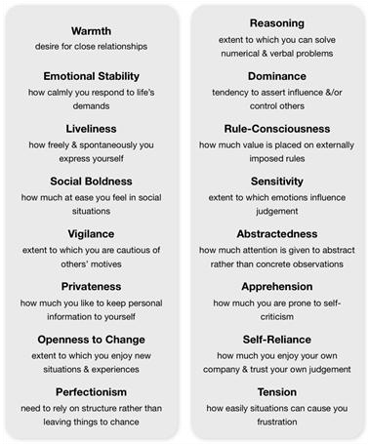
The Sixteen Personal Factors: 16PF

Slide 21
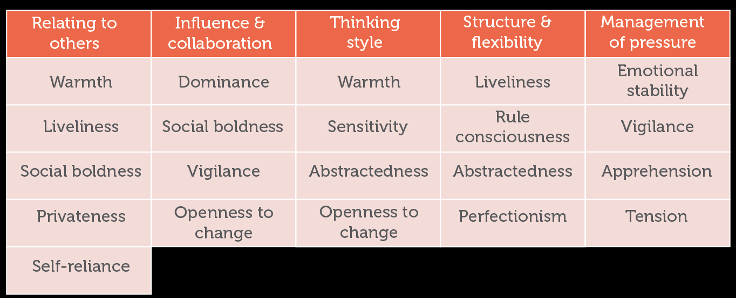
16PF Global Factors and their Contributing Primaries
EXTRAVERSION/ INTROVERSION | INDEPENDENCE / ACCOMMODATION | TOUGH MINDEDNESS / RECEPTIVITY | SELF CONTROL / LACK OF RESTRAINT | HIGH ANXIETY/ LOW ANXIETY

Slide 22
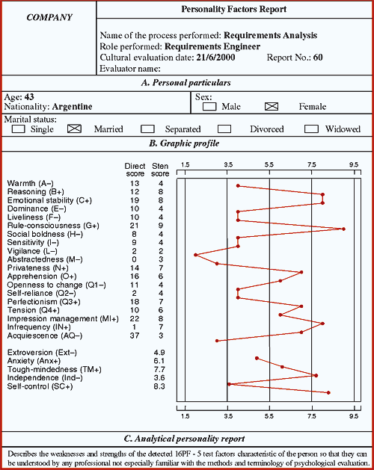

Slide 23
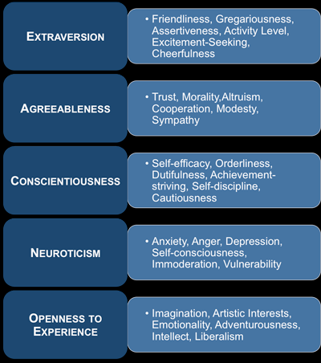
The Big Five Personality Factors
Costa & McCrae (1992)

Slide 24
Receptivity and Openness (Big Five)
Openness to…
People (Warmth+)
Feelings (Sensitivity+)
Imagination and Fantasy (Abstractedness+)
Change (Openness to Change+)
‘Receptive individuals tend to welcome rich and varied experiences. They pay attention to emotions, intuition, artistic values, and other subjective aspects of experience. They are interested in aesthetics, ideas, theories and new approaches.’ (Cattell & Schuerger, 2003: 37)

Slide 25
Taking Initiative and the 16PF
High scorers on Dominance tend to:
‘be actively self-determined in their thinking and actions and to take initiative in getting the things they want in life’ (p.38)
‘have a reputation for getting things done because they are likely to take the initiative and to be stubborn in response to challenging events or situations’ (p.61)
‘are typically employed in occupations that involve managing or influencing people or in taking initiative in managing and pursuing ideas, projects or goals’ (p.64) (Cattell & Schuerger, 2003)

Slide 26
Taking Initiative for Change
Ability to take action unprompted (Higher Education Academy 2007). The ability to act independently and with a fresh approach (Oxford English Dictionary 2007). Employer's definition: 'Initiative is something you take on yourself. A conscious decision, to "do" day by day: it's an attitude of mind.' 'Initiative begins with attunement that facilitates awareness and analytical and systematic thinking.'

Slide 27
References
Boyatzis, R. and McKee, A. (2005) Resonant Leadership: Renewing Yourself and Connecting with Others through Mindfulness, Hope and Compassion. Harvard Business School Press. Boston.
Boyatzis, R. and Smith, M. (2012a) ‘Positive Renewal. Can you keep going?’ Leadership Excellence, March, p.6.
Boyatzis, R. E., Passarelli, A. M., Koenig, K., Lowe, M., Mathew, B., Stoller, J. K., & Phillips, M. (2012b) ‘Examination of the neural substrates activated in memories of experiences with resonant and dissonant leaders.’ The Leadership Quarterly, 23(2): 259–272.
Boyatzis, R. (2014) ‘Possible Contributions to Leadership and Management Development From Neuroscience. ‘ Academy of Management Learning & Education, Vol. 13 Issue 2, p300-303
Cattell, H.E.P. & Schuerger, J.M. (2003) Essentials of 16PF Assessment, Wiley
Costa, P.T.,Jr. & McCrae, R.R. (1992). Revised NEO Personality Inventory (NEO-PI-R) and NEO Five-Factor Inventory (NEO-FFI) manual. Odessa, FL: Psychological Assessment Resources
Frankl, Viktor E. (2006) Man’s Search for Freedom, Beacon Books.
Harland, L., Harrison, W., Jones, J., & Reiter-Palmon, R. (2005) ‘Leadership behaviors and subordinate resilience.’ Journal of Leadership & Organizational Studies, 11/2: 2-14
McKee, A., Johnston, F. & Massimilian, R. (2006) ‘Mindfulness, Hope and Compassion: A Leader’s Road Map to Renewal’ Ivey Business Journal May/June, pp.1-5 http://www.teleosleaders.com/assets/pdf/Ivey_Mindfulness.pdf
Crum, T. (1987) The Magic of Conflict-Turning a Life of Work into a Work of Art. Touchstone

